Slide 1
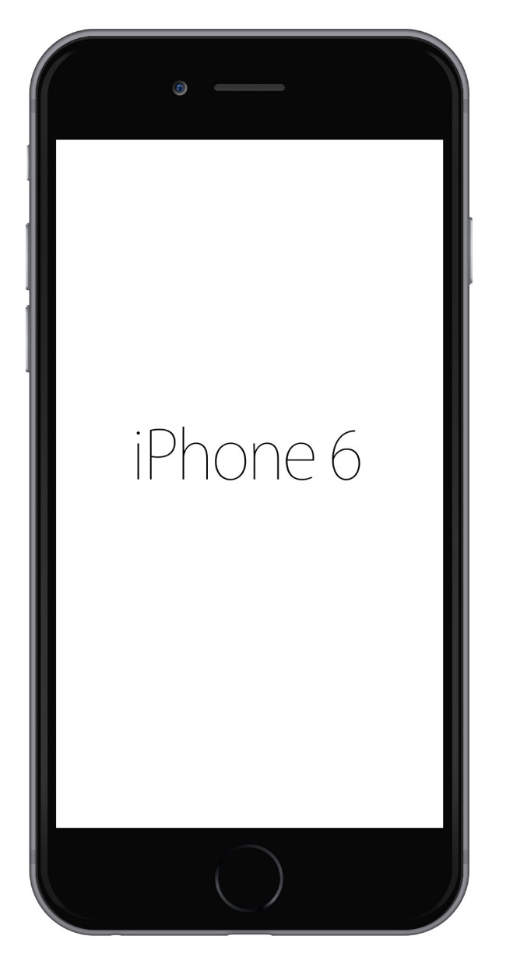

Mobile Web Layout 1
Home | VIP | Real-time
Welcome
Enter your mobile number:
+63
Service to be availed:
Warts Removal
Send me SMS Notifications
Enter Queue
Queue
Now Serving
Counter 1: N5
Counter 2: V2
3
VIP’s on Queue
8
Guests on Queue
Some credits here ….
Name | of the | Members

Slide 2
Mobile Web Layout 2
Home VIP Real-time
Welcome
Enter your mobile number:
+63
Service to be availed:
Warts Removal
Send me SMS Notifications
Enter Queue
Queue
Now Serving
Counter 1: N5
Counter 2: V2
3
VIP’s on Queue
8
Guests on Queue
Some credits here ….
Name | of the | Members

Slide 3
Desktop Web Layout
Home | VIP | Real-time
Welcome
Queue
Enter your mobile number:
Now Serving
Counter 1: N5
Counter 2: V2
+63
Service to be availed:
Warts Removal
3
VIP’s on Queue
8
Guests on Queue
Send me SMS Notifications
Enter Queue
Some credits here ….
Name | of the | Members

Slide 4
Mobile Web Layout 3
Home
Welcome
Enter your mobile number:
+63
Service to be availed:
Warts Removal
Send me SMS Notifications
Enter Queue
Queue
Now Serving
Counter 1: N5
Counter 2: V2
3
VIP’s on Queue
8
Guests on Queue
Some credits here ….
Name | of the | Members

Slide 5
Mobile Web Layout 3
Home
VIP Login
Real-time Queue Status
Expands Menu
once clicked
Welcome
Enter your mobile number:
+63
Service to be availed:
Warts Removal
Send me SMS Notifications
Enter Queue
Queue
Now Serving
Counter 1: N5
Counter 2: V2
3
VIP’s on Queue
8
Guests on Queue
Some credits here ….
Name | of the | Members

